Slide 1
Visualization in R
Notes:
Welcome to the module on data manipulation with R

Slide 2
Visualization in R
Base Graphics
ggplot2()
Notes:
In this session we’ll discuss the following topics:
As far as the manipulation of tabular data is concerned we’ll discuss the base R functions and also we’ll demonstrate in detail about the functionality of a very powerful data manipulation package called dplyr(). Discussion on how date objects are manipulated in R will be undertaken. We’ll touch upon how two data frames can be joined together, how we deal with missing values and how simple transpositions can be done in R. For those who are very well versed at executing sql queries, we’ll briefly describe how sql queries can be executed from within R using sqldf() package.

Slide 3
Visualization: Base Graphics

Slide 4
Data Visualization: Base Graphics
plot(): Bivariate relationships and continuous variable across groups
Doing Univariate analysis: hist(), boxplot()
Making more than 1 plot using mfrow()
Notes:
So, lets get started with data manipulation of tabular data using base R functions. The whole data manipulation exercise for tabular data (data in data frames) can be thought of as consisting of :
Subsetting the data: Selecting some rows out of our data frame
Selecting specific columns from our data frame
Adding new columns to our existing data frame
Arranging our data in ascending or descending order
Producing group wise summaries
Constructing contingency tables

Slide 5
Base Graphics: plot()
Notes:
Siubsetting means selecting some rows out of our data frame. In order to understand this let us load a data in our R session.

Slide 6
Plot
The package used for Base Graphics in R is “graphics”
The plot function can be used for plotting
numeric variables
character and factor variables
Scatter plots
Entire dataset

Slide 7
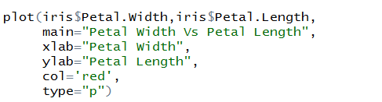
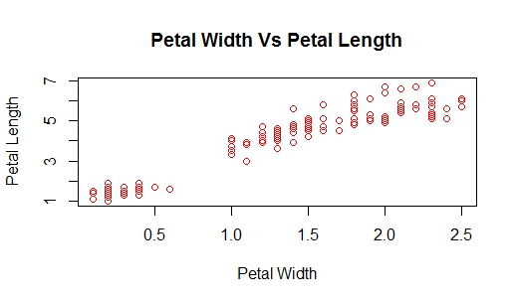
Plot : scatter plot
type :
the type of plot
Some of the types are :
p=point
l=line
b= point and line

Slide 8

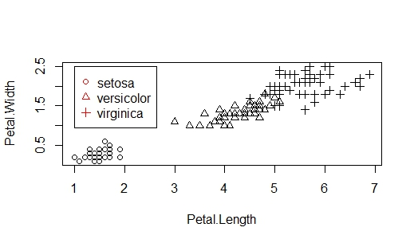
Plot : pch
pch :
Used for plotting symbols
Values = 0:18

Slide 9
Studying Univariates()
Notes:
Siubsetting means selecting some rows out of our data frame. In order to understand this let us load a data in our R session.

Slide 10
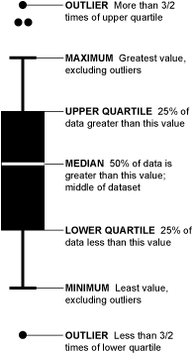
cex
Box and whiskers plot
Boxplots are useful for studying the distribution of a variable
Also useful for detecting outliers

Slide 11

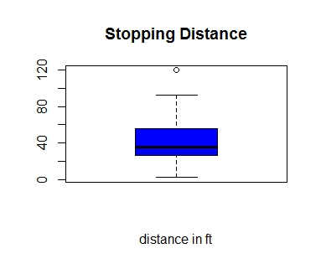
cex
Box and whiskers plot

Slide 12
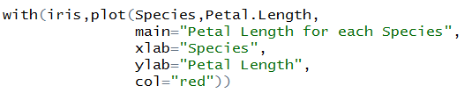
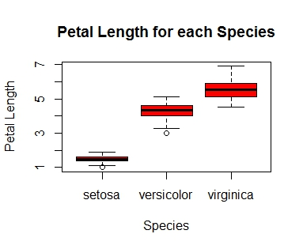
Plot : Factor variables

Slide 13
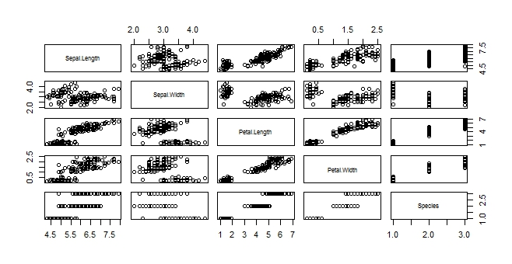
Plot : Entire Dataframe
plot function on the entire dataset generates pairwise displays

Slide 14
cex
par()
par() function is useful for setting additional graphics parameters
Some of the parameters this function has are :
mfrow
cex.main
cex.lab
To know the entire list of grahics parameters in par that can be altered :
?par

Slide 15
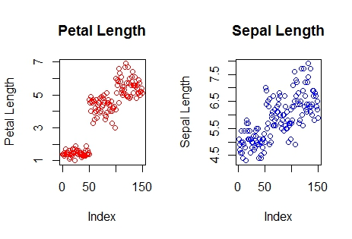
cex
par(): multi-plotting
mfrow() :
It controls the number of rows and columns, allowing you to put multiple plots on a page

Slide 16
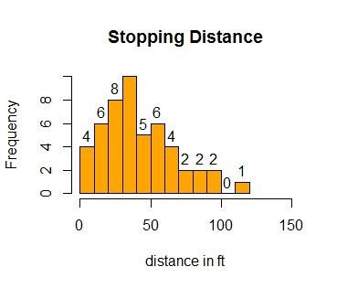
cex
Histograms
Histograms give the frequency distribution of a variable.
hist() function is used
breaks : The number of bins
label : Labels the frequency of each bin
xlim : sets the range for x-axis

Slide 17
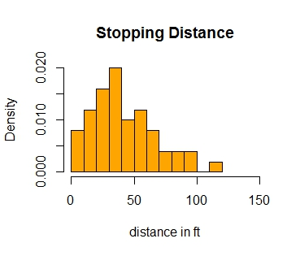
cex
Histogram : freq
freq :
freq=TRUE(default) means frequency distribution
freq=FALSE means probability density

Slide 18


cex
Histogram : adding density lines

Slide 19
Visualization: ggplot2()

Slide 20
Visualization: ggplot2()
ggplot2(): What and Why
ggplot2(): Architecture : Understanding Grammar of Graphics
ggplot2(): Common plots
Notes:
So, lets get started with data manipulation of tabular data using base R functions. The whole data manipulation exercise for tabular data (data in data frames) can be thought of as consisting of :
Subsetting the data: Selecting some rows out of our data frame
Selecting specific columns from our data frame
Adding new columns to our existing data frame
Arranging our data in ascending or descending order
Producing group wise summaries
Constructing contingency tables

Slide 21
Visualization: ggplot2()
Base graphics: Good for simple tasks
Comparatively difficult syntax
Based on grammar of graphics: Simple syntax, interfaces with ggmap and other packages
Notes:
So, lets get started with data manipulation of tabular data using base R functions. The whole data manipulation exercise for tabular data (data in data frames) can be thought of as consisting of :
Subsetting the data: Selecting some rows out of our data frame
Selecting specific columns from our data frame
Adding new columns to our existing data frame
Arranging our data in ascending or descending order
Producing group wise summaries
Constructing contingency tables

Slide 22
Grammar of Graphics

Slide 23
Visualization: ggplot2()
“Grammar of graphics”
A plot composed of : Aesthetic Mapping, Geoms, Statistical Transformations, Coordinate Systems and Scales
Components | Description
Aesthetic Mapping | What component of data appears on X axis, Y axis, how is the color, size, fill and position of elements is related with the data
Geoms (Geometrical Objects) | What geometrical objects appear on the plot: points, lines, polygons, area, boxplot, rectangle, tile etc
Statistical Transformations | Compute density, counts, (Histogram: Need to bin and count data)
Scales and Coordinate System | Discreet scale or Continous. Cartesian or Spherical.
Notes:
So, lets get started with data manipulation of tabular data using base R functions. The whole data manipulation exercise for tabular data (data in data frames) can be thought of as consisting of :
Subsetting the data: Selecting some rows out of our data frame
Selecting specific columns from our data frame
Adding new columns to our existing data frame
Arranging our data in ascending or descending order
Producing group wise summaries
Constructing contingency tables

Slide 24
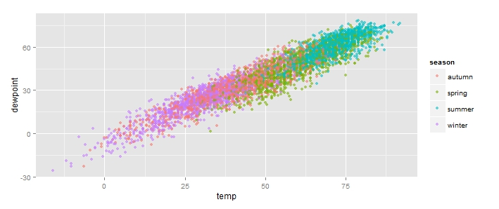
Visualization: ggplot2()
temp | dewpoint | season
12 | 30 | Autumn
34 | 28 | Spring
… | … | Summer
0 | 0 | Winter
… | … | ….
Based on “grammar of graphics”
Components: Aesthetics, Geoms and Statistical Transformations
Notes:
So, lets get started with data manipulation of tabular data using base R functions. The whole data manipulation exercise for tabular data (data in data frames) can be thought of as consisting of :
Subsetting the data: Selecting some rows out of our data frame
Selecting specific columns from our data frame
Adding new columns to our existing data frame
Arranging our data in ascending or descending order
Producing group wise summaries
Constructing contingency tables

Slide 25
Visualization: ggplot2()
Aesthetics:
Axis Mappings: X=temp, y=dewpoint
Colour: Seasons
Based on “grammar of graphics”
Components: Aesthetics, Geoms and Statistical Transformations
Notes:
So, lets get started with data manipulation of tabular data using base R functions. The whole data manipulation exercise for tabular data (data in data frames) can be thought of as consisting of :
Subsetting the data: Selecting some rows out of our data frame
Selecting specific columns from our data frame
Adding new columns to our existing data frame
Arranging our data in ascending or descending order
Producing group wise summaries
Constructing contingency tables

Slide 26
Visualization: ggplot2()
Geoms:
Points (Scatter plot)
Bars, Lines, Polygons, Area, Density, Boxplots….
Based on “grammar of graphics”
Components: Aesthetics, Geoms and Statistical Transformations
Notes:
So, lets get started with data manipulation of tabular data using base R functions. The whole data manipulation exercise for tabular data (data in data frames) can be thought of as consisting of :
Subsetting the data: Selecting some rows out of our data frame
Selecting specific columns from our data frame
Adding new columns to our existing data frame
Arranging our data in ascending or descending order
Producing group wise summaries
Constructing contingency tables

Slide 27
Visualization: ggplot2()
Statistical Transformation
Identity (none)
Based on “grammar of graphics”
Components: Aesthetics, Geoms and Statistical Transformations
Notes:
So, lets get started with data manipulation of tabular data using base R functions. The whole data manipulation exercise for tabular data (data in data frames) can be thought of as consisting of :
Subsetting the data: Selecting some rows out of our data frame
Selecting specific columns from our data frame
Adding new columns to our existing data frame
Arranging our data in ascending or descending order
Producing group wise summaries
Constructing contingency tables

Slide 28
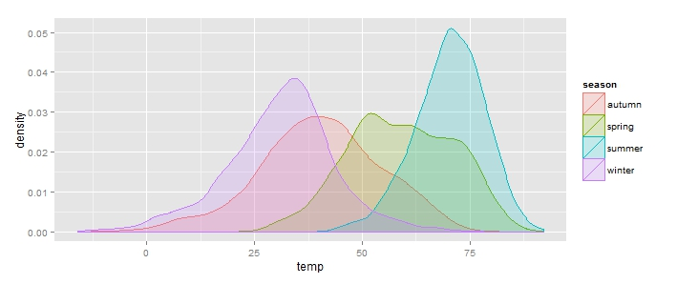
Visualization: ggplot2()
Geoms:
Density
Aesthetics:
Axis Mappings:
X=temp,
Y= density
Fill: Seasons
Statistical Transformation:
Density computation
Based on “grammar of graphics”
Components: Aesthetics, Geoms and Statistical Transformations
Notes:
So, lets get started with data manipulation of tabular data using base R functions. The whole data manipulation exercise for tabular data (data in data frames) can be thought of as consisting of :
Subsetting the data: Selecting some rows out of our data frame
Selecting specific columns from our data frame
Adding new columns to our existing data frame
Arranging our data in ascending or descending order
Producing group wise summaries
Constructing contingency tables

Slide 29
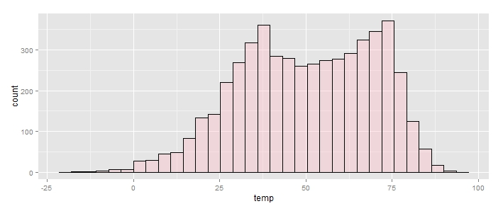
Visualization: ggplot2()
Geoms:
?
Aesthetics:
Axis Mappings:
X=?,
Y= ?
Fill: ?
Statistical Transformation:
?
Based on “grammar of graphics”
Components: Aesthetics, Geoms and Statistical Transformations
Notes:
So, lets get started with data manipulation of tabular data using base R functions. The whole data manipulation exercise for tabular data (data in data frames) can be thought of as consisting of :
Subsetting the data: Selecting some rows out of our data frame
Selecting specific columns from our data frame
Adding new columns to our existing data frame
Arranging our data in ascending or descending order
Producing group wise summaries
Constructing contingency tables

Slide 30
Visualization: ggplot2()
Geoms:
Bar
Aesthetics:
Axis Mappings:
X=temp
Y= Counts
Fill: Pink
Statistical Transformation:
Counts in binned data
Based on “grammar of graphics”
Components: Aesthetics, Geoms and Statistical Transformations
Notes:
So, lets get started with data manipulation of tabular data using base R functions. The whole data manipulation exercise for tabular data (data in data frames) can be thought of as consisting of :
Subsetting the data: Selecting some rows out of our data frame
Selecting specific columns from our data frame
Adding new columns to our existing data frame
Arranging our data in ascending or descending order
Producing group wise summaries
Constructing contingency tables

Slide 31
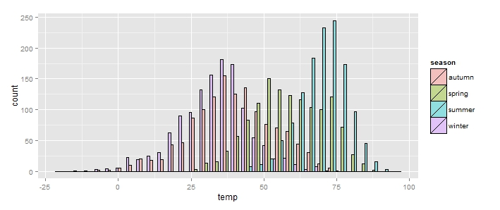
Visualization: ggplot2()
Geoms:
?
Aesthetics:
Axis Mappings:
X=?,
Y= ?
Fill: ?
Statistical Transformation:
?
Position:?
Based on “grammar of graphics”
Components: Aesthetics, Geoms and Statistical Transformations
Notes:
So, lets get started with data manipulation of tabular data using base R functions. The whole data manipulation exercise for tabular data (data in data frames) can be thought of as consisting of :
Subsetting the data: Selecting some rows out of our data frame
Selecting specific columns from our data frame
Adding new columns to our existing data frame
Arranging our data in ascending or descending order
Producing group wise summaries
Constructing contingency tables

Slide 32
Visualization: ggplot2()
Geoms:
Bars
Aesthetics:
Axis Mappings:
X=temp
Y= Counts
Fill: seasons
Statistical Transformation:
Count
Position: Bars arranged side by side (Dodged)
Based on “grammar of graphics”
Components: Aesthetics, Geoms and Statistical Transformations
Notes:
So, lets get started with data manipulation of tabular data using base R functions. The whole data manipulation exercise for tabular data (data in data frames) can be thought of as consisting of :
Subsetting the data: Selecting some rows out of our data frame
Selecting specific columns from our data frame
Adding new columns to our existing data frame
Arranging our data in ascending or descending order
Producing group wise summaries
Constructing contingency tables

Slide 33
Visualization: ggplot2()
How to code the grammar?
Setting up aesthetic maps:
ggplot(data,aes(x=variable to be mapped to x axis,y=variable to be mapped to y axis,colour=variable by which colour should change))
Notes:
So, lets get started with data manipulation of tabular data using base R functions. The whole data manipulation exercise for tabular data (data in data frames) can be thought of as consisting of :
Subsetting the data: Selecting some rows out of our data frame
Selecting specific columns from our data frame
Adding new columns to our existing data frame
Arranging our data in ascending or descending order
Producing group wise summaries
Constructing contingency tables

Slide 34
Visualization: ggplot2()
How to code the grammar?
Adding layer with geom:
p+geom_type of geometry(stat=“statistical transformation on data”)
Notes:
So, lets get started with data manipulation of tabular data using base R functions. The whole data manipulation exercise for tabular data (data in data frames) can be thought of as consisting of :
Subsetting the data: Selecting some rows out of our data frame
Selecting specific columns from our data frame
Adding new columns to our existing data frame
Arranging our data in ascending or descending order
Producing group wise summaries
Constructing contingency tables

Slide 35
Visualization: ggplot2()
Notes:
So, lets get started with data manipulation of tabular data using base R functions. The whole data manipulation exercise for tabular data (data in data frames) can be thought of as consisting of :
Subsetting the data: Selecting some rows out of our data frame
Selecting specific columns from our data frame
Adding new columns to our existing data frame
Arranging our data in ascending or descending order
Producing group wise summaries
Constructing contingency tables

Slide 36
Visualization: ggplot2()
Geom | Default Stat | Default Aesthetics
geom_point | “identity” | colour,fill,shape,size,x,y
geom_histogram | “bin” | colour,fill,linetype,size,weight,x
geom_density | “density” | colour,fill,linetype,size,weight,x,y
geom_polygon | “identity” | colour,fill,linetype,size,x,y
geom_line | “identity” | colour, linetype, size, x, y
geom_tile | “identity” | colour, fill, linetype, size, x, y
geom_boxplot | “boxplot” | colour, fill, lower, middle, size, upper, weight, x, ymax, ymin
*Items in bold are required, others are optional and have default values or are computed by a default stat transform
Notes:
So, lets get started with data manipulation of tabular data using base R functions. The whole data manipulation exercise for tabular data (data in data frames) can be thought of as consisting of :
Subsetting the data: Selecting some rows out of our data frame
Selecting specific columns from our data frame
Adding new columns to our existing data frame
Arranging our data in ascending or descending order
Producing group wise summaries
Constructing contingency tables

Slide 37
Creating Common Plots

Slide 38
Visualization: ggplot2()
Direct Marketing dataset with information demographic information such as age, location, income level; and information on the amount of money spent by the individual
Following are the variables:
Age
Gender
Own Home
Married
Location
Salary
Children
History
Catalogs
Amount Spent
Notes:
So, lets get started with data manipulation of tabular data using base R functions. The whole data manipulation exercise for tabular data (data in data frames) can be thought of as consisting of :
Subsetting the data: Selecting some rows out of our data frame
Selecting specific columns from our data frame
Adding new columns to our existing data frame
Arranging our data in ascending or descending order
Producing group wise summaries
Constructing contingency tables

Slide 39
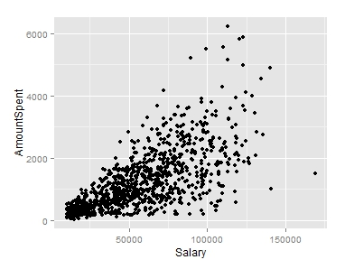
Visualization: ggplot2()
Bivariate Relationship: Scatter plot
Geoms:
Point: geom_point()
Aesthetics:
Axis Mappings:
X=X variable
Y= Y Variables
Fill, Color, Size…optional
Statistical Transformation
Identity (No change)
Notes:
So, lets get started with data manipulation of tabular data using base R functions. The whole data manipulation exercise for tabular data (data in data frames) can be thought of as consisting of :
Subsetting the data: Selecting some rows out of our data frame
Selecting specific columns from our data frame
Adding new columns to our existing data frame
Arranging our data in ascending or descending order
Producing group wise summaries
Constructing contingency tables

Slide 40
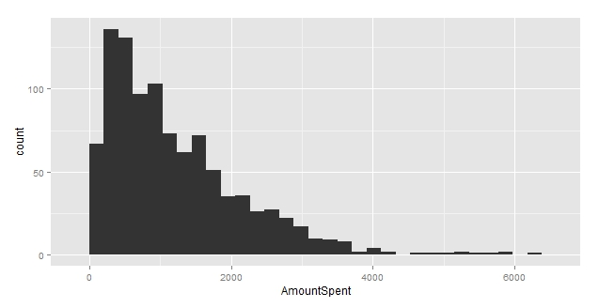
Visualization: ggplot2()
Understanding univarites : Histograms
Geoms:
Bars: geom_histogram()
Aesthetics:
Axis Mappings:
X=X variable
Y= Count of data in Bins
Fill, Colour, …optional
Statistical Transformation
bins (Binned count of observations, to be shown on Y axis)
Notes:
So, lets get started with data manipulation of tabular data using base R functions. The whole data manipulation exercise for tabular data (data in data frames) can be thought of as consisting of :
Subsetting the data: Selecting some rows out of our data frame
Selecting specific columns from our data frame
Adding new columns to our existing data frame
Arranging our data in ascending or descending order
Producing group wise summaries
Constructing contingency tables

Slide 41
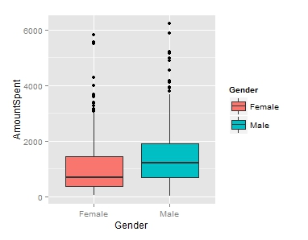
Visualization: ggplot2()
Understanding univarites : Box and Whiskers
Geoms:
Boxplot: geom_boxplot()
Aesthetics:
Axis Mappings:
X=X variable (A factor variable)
Y=The variable whose mapping we are interested in, Boxplot statistics : lower, middle, upper, ymax, ymin
Colour, fill
Statistical Transformation
Boxplot statistics (To be shown on Y axis)
Notes:
So, lets get started with data manipulation of tabular data using base R functions. The whole data manipulation exercise for tabular data (data in data frames) can be thought of as consisting of :
Subsetting the data: Selecting some rows out of our data frame
Selecting specific columns from our data frame
Adding new columns to our existing data frame
Arranging our data in ascending or descending order
Producing group wise summaries
Constructing contingency tables

Slide 42
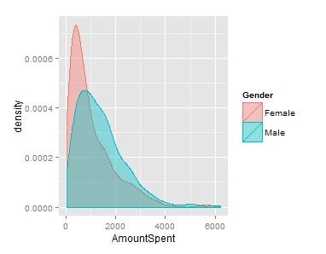
Visualization: ggplot2()
Understanding univariates : Density plots
Geoms:
geom_density()
Aesthetics:
Axis Mappings:
X=Variable whose density we are interested in.
Y=Density measurements
Colour, fill…..
Statistical Transformation
Density (To be shown on Y axis)
Notes:
So, lets get started with data manipulation of tabular data using base R functions. The whole data manipulation exercise for tabular data (data in data frames) can be thought of as consisting of :
Subsetting the data: Selecting some rows out of our data frame
Selecting specific columns from our data frame
Adding new columns to our existing data frame
Arranging our data in ascending or descending order
Producing group wise summaries
Constructing contingency tables

Slide 43
Visualization: ggplot2()
Understanding univariates : Density plots
Geoms:
geom_density()
Aesthetics:
Axis Mappings:
X=Variable whose density we are interested in.
Y=Density measurements
Colour, fill…..
Statistical Transformation
Density (To be shown on Y axis)
Notes:
So, lets get started with data manipulation of tabular data using base R functions. The whole data manipulation exercise for tabular data (data in data frames) can be thought of as consisting of :
Subsetting the data: Selecting some rows out of our data frame
Selecting specific columns from our data frame
Adding new columns to our existing data frame
Arranging our data in ascending or descending order
Producing group wise summaries
Constructing contingency tables

Slide 44
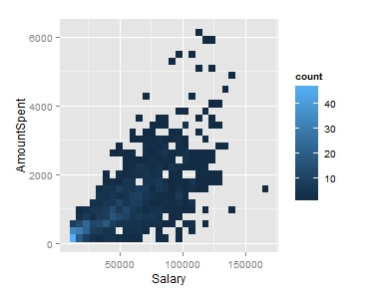
Visualization: ggplot2()
Understanding bivariate counts : 2 d bivariate plots, 2d heatmaps
Geoms:
geom_bin2d()
Aesthetics:
Axis Mappings:
X= X variable
Y= Y variable
Colour, fill…..
Statistical Transformation
2 d density
Notes:
So, lets get started with data manipulation of tabular data using base R functions. The whole data manipulation exercise for tabular data (data in data frames) can be thought of as consisting of :
Subsetting the data: Selecting some rows out of our data frame
Selecting specific columns from our data frame
Adding new columns to our existing data frame
Arranging our data in ascending or descending order
Producing group wise summaries
Constructing contingency tables

